Slide 1
Service for temporary mail
Created by
students of group IV-71
Humeniuk Oleksandr
Bordyug Oleksandr
Povkh Mykhailo

Slide 2
Why do you need it?
To avoid spam
To give activation messages without your main e-mail
If you don’t want to show your main e-mail address
This mail can’t be used by anyone to send useful messages
We have some features which help you to do anything with this mail easily.

Slide 3
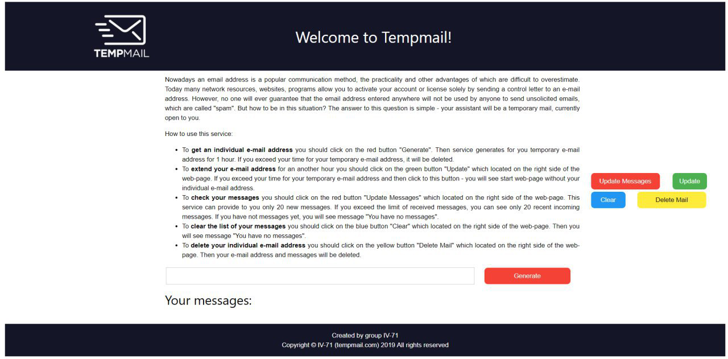
What it looks like?

Slide 4
Features of our service
You can generate your e-mail address by one click
Registration without spam on your e-mail address
Deleting mail by one click
Detailing information about messages(time, subject, from and message text)

Slide 5
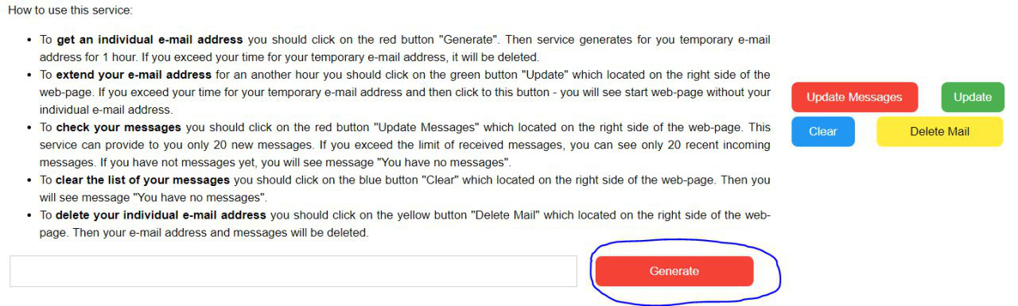
How to use on practise
1. Creating an e-mail address

Slide 6
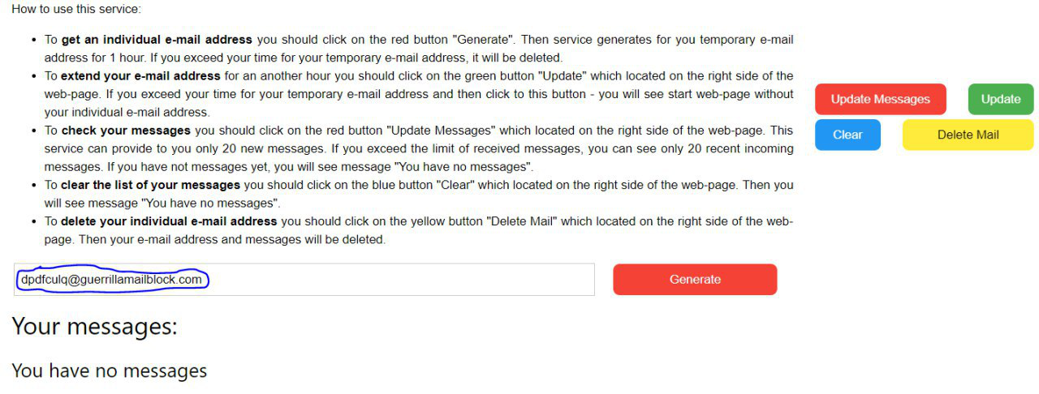
After clicking:

Slide 7
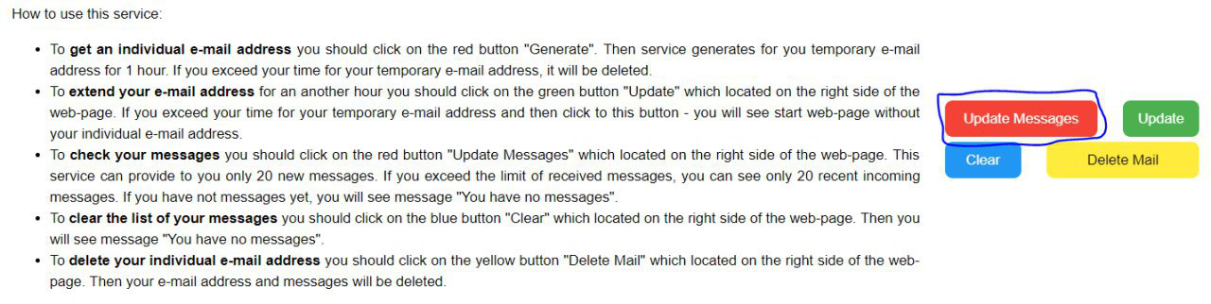
2. Checking messages

Slide 8
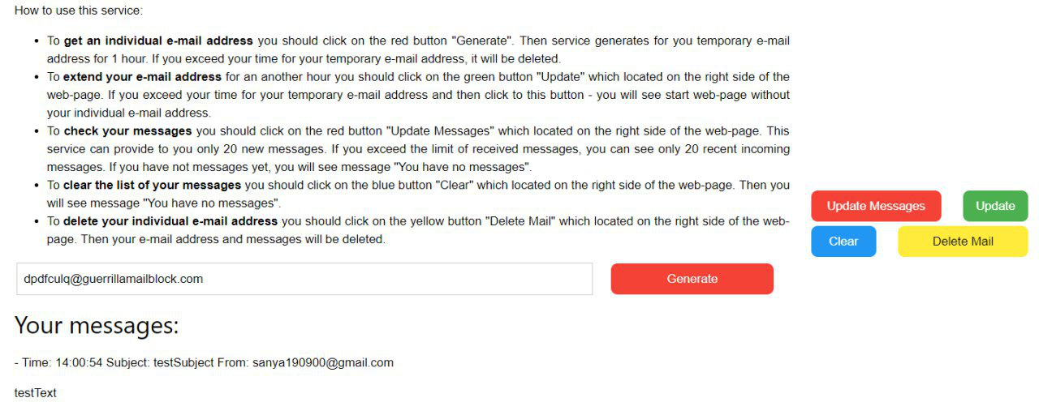
After clicking:

Slide 9
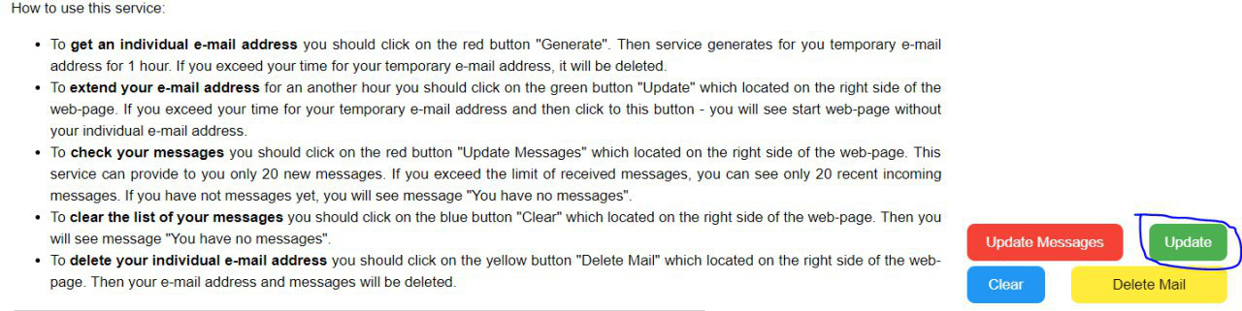
3. Extending e-mail address

Slide 10
4. How to clear messages
Before clicking “Clear”:

Slide 11
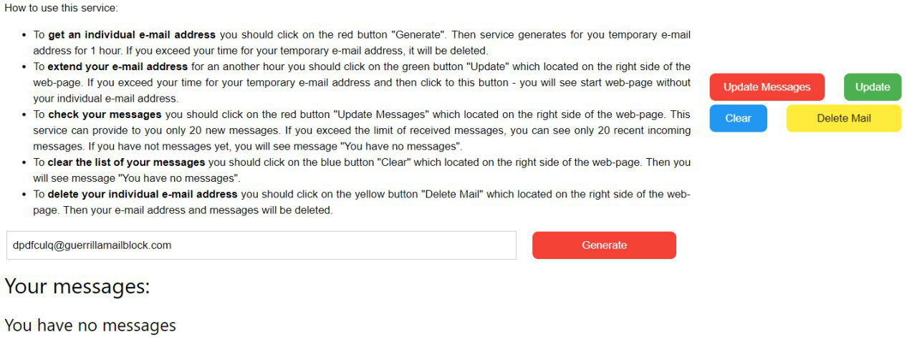
After clicking:

Slide 12
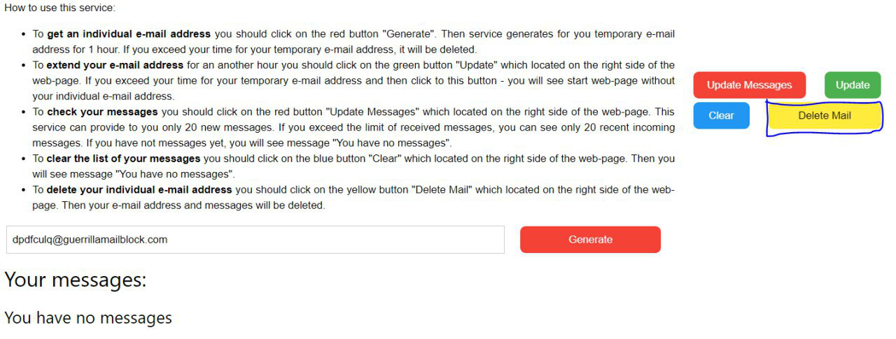
5. Deleting e-mail address
Before clicking:

Slide 13
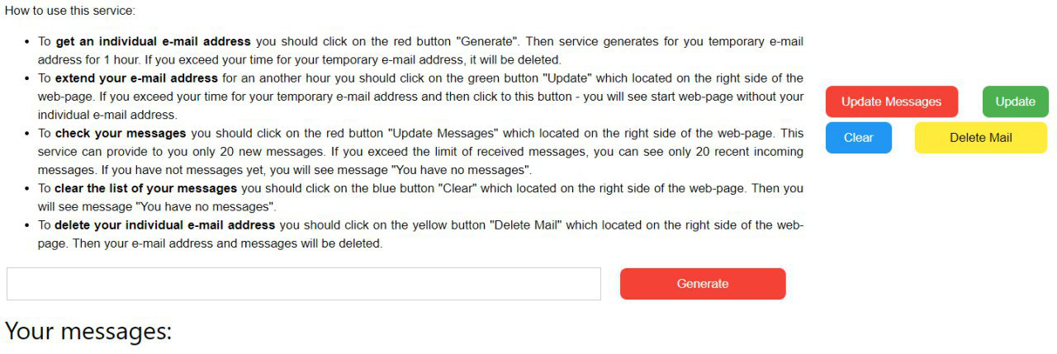
After clicking:

Slide 14
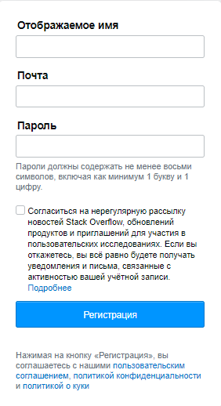
Example of registration on https://ru.stackoverflow.com/

Slide 15
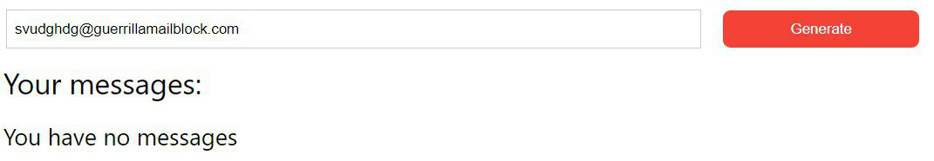
After clicking “Generate ” you have an e-mail:

Slide 16
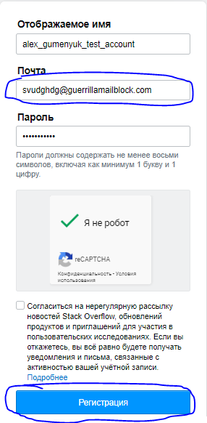
Filling the registration form:

Slide 17
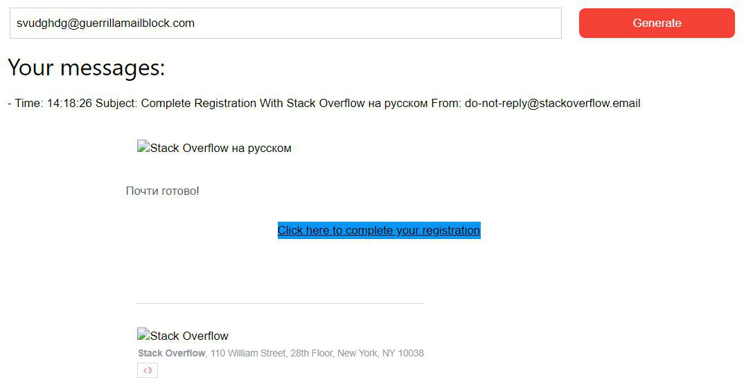
Updating messages and then click on the link:

Slide 18
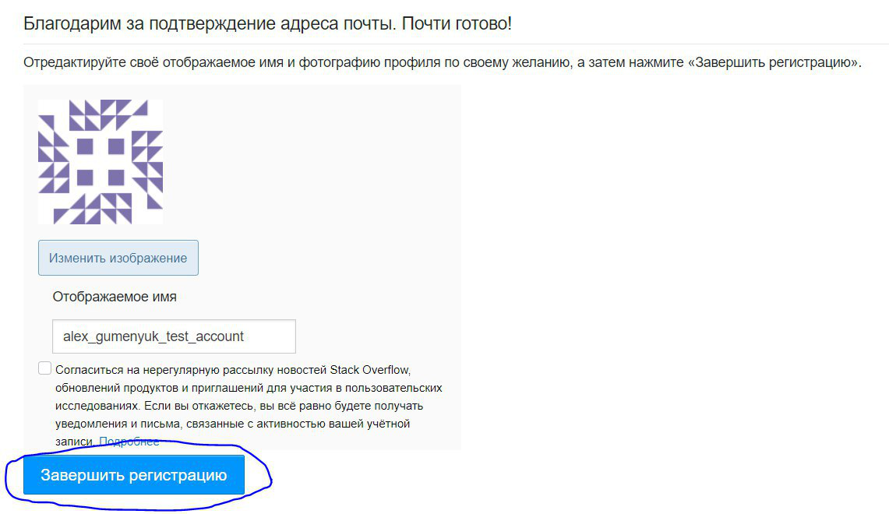
End of registration:

Slide 19
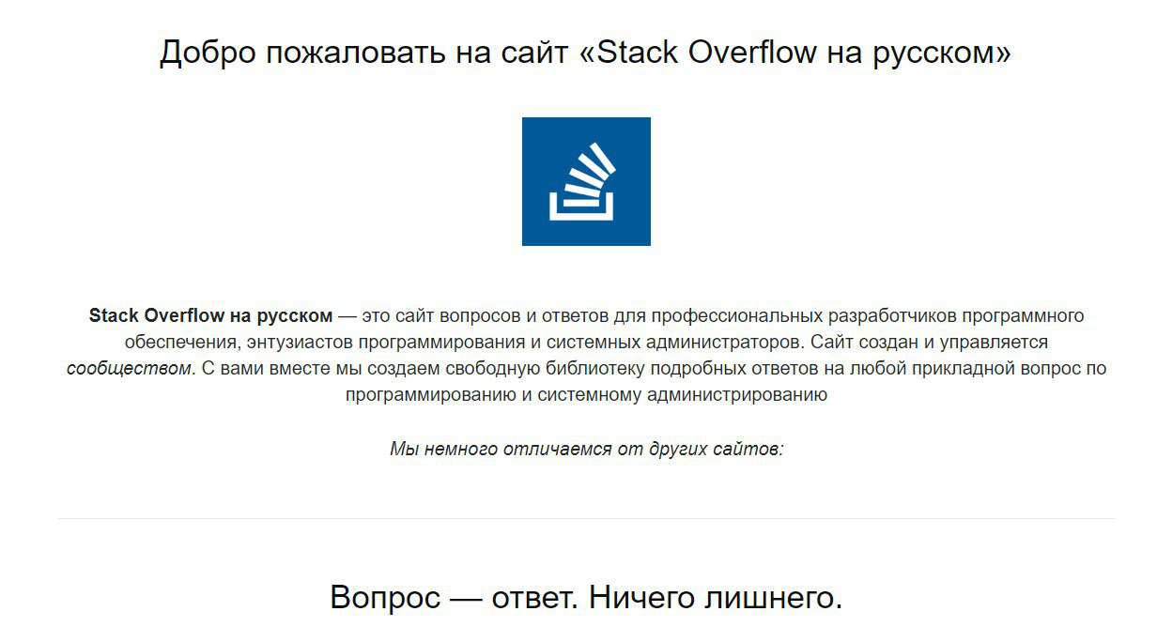

Slide 20
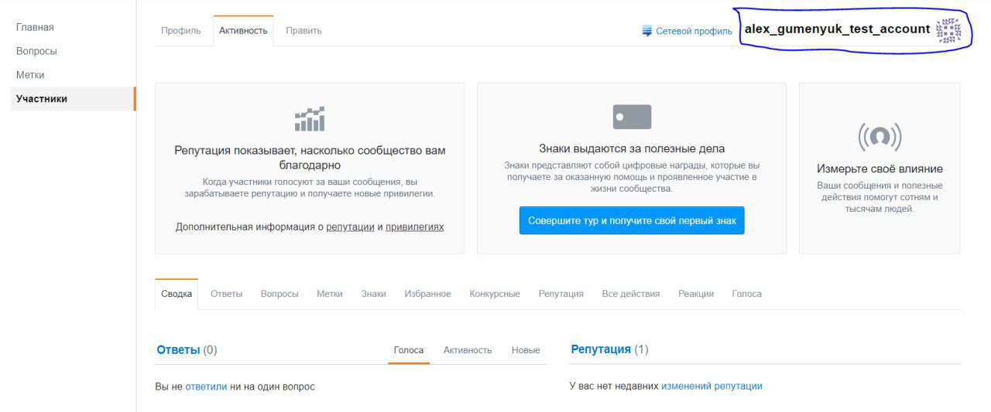
So, your account was created:

Slide 21
Conclusions
If you want to create temporary mail – out service will help you
Plain interface
Easy to work
Good features
It does not mistakes

Slide 22
Have a nice work with our service! Thanks for attention!

